Slide 1

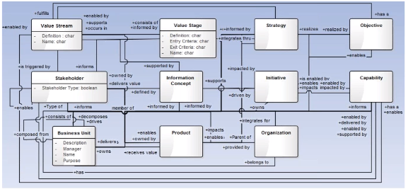
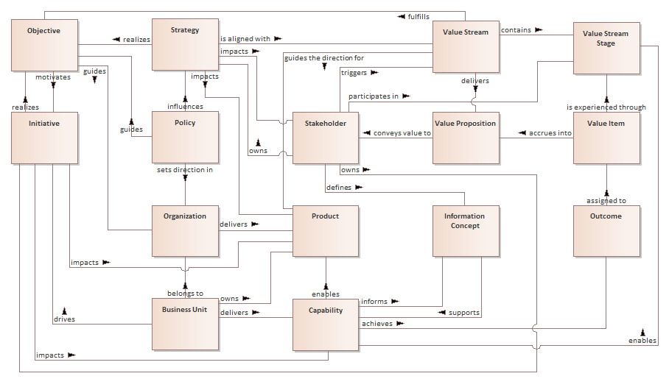
A revised top-level metamodel
Replacing figure 5.1.2
Bert Hooyman, Metamodel Team, BA Guild
March 26, 2018

Slide 2
BIZBOK Meta Model
Conceptual view of Business Architecture Concepts and Relationships

Slide 3
What is new?
New objects & associations
object | predicate | subject | new?
Strategy | realizes | Objective | new association
Strategy | impacts | Stakeholder | new association
Policy | influences | Strategy | new object
Policy | guides | Objective | new object
Policy | sets direction in | Organization | new object
Value Stream | fulfills | Objective | new association
Value Stream | delivers | Value Proposition | new subject
Value Item | accrues into | Value Proposition | new object & subject
Value Proposition | conveys value to | Stakeholder | new object
Outcome | assigned to | Value Item | new object (in diagram)
Business Unit | drives | Initiative | new association

Slide 4
What has changed?
Modifications to existing associations
object | predicate | Subject | changed?
Organization | delivers | Product | renamed from 'provides'
Stakeholder | defines | Information Concept | reversed direction
Capability | achieves | Outcome | renamed from 'produces'
Value Item | conveys value to | Stakeholder | now via Value Proposition

Slide 5
What has been left out?
Suppressed for clarity; ranked as secondary
Object | predicate | Subject | Bert's remarks
Business Unit | decomposes into | Business Unit | suppressed
Capability | decomposes into | Capability | suppressed
Outcome | is categorized with | Outcome | suppressed
Information Concept | informs | Objective | suppressed, reversed
Organization | organizes | Organization | suppressed
Organization | integrates through | Strategy | challenged
Stakeholder | may be an | Organization | suppressed
Stakeholder | experiences | Value Stream Stage | suppressed

Slide 6
What remains as is?
Object | predicate | Subject |  | Object | predicate | Subject
Objective | motivates | Initiative |  | Value Stream | guides the direction for | Product
Objective | guides | Organization |  | Value Item | is experienced through | Value Stream Stage
Strategy | is aligned with | Value Stream |  | Information Concept | supports | Capability
Initiative | realizes | Objective |  | Capability | informs | Information Concept
Initiative | impacts | Product |  | Capability | enables | Product
Initiative | impacts | Capability |  | Capability | enables | Value Stream Stage
Stakeholder | owns | Strategy |  | Business Unit | owns | Product
Stakeholder | owns | Initiative |  | Business Unit | delivers | Capability
Stakeholder | triggers | Value Stream |  | Business Unit | belongs to | Organization
Stakeholder | participates in | Value Stream Stage |  | Strategy | impacts | Product
Value Stream | contains | Value Stream Stage

Slide 7

Concept definitions
Concept | Definition
Objective | Measurable goals for guiding strategy and aligning initiatives with execution. Objectives can be applied at individual, operational, business unit, and organizational levels. Also: A quantitative, measurable result that defines strategy.
Strategy | The pattern or plan that integrates an organization’s major goals, policies, and action sequences into a cohesive whole.
Initiative | A course of action that is being executed or has been selected for execution.
Organization | An organization is a social unit of people, systematically structured and managed to meet a need or to pursue collective goals on a continuing basis.
Policy | A course or principle of action adopted or proposed by a government, party, business or individual
Stakeholder | An internal or external individual or organization with a vested interest in achieving value through a particular outcome.
Value Stream | An end-to-end collection of activities that create a result for a customer, who may be the ultimate customer or an internal end-user of the value stream.
Value Stream Stage | A distinct, identifiable phase or step within a value stream that has a unique name, entrance criteria, exit criteria, and identifiable participating stakeholder(s).
Value Item | The judgment of worth, made by an individual or organization, attached to something tangible or intangible and attained in the course of a particular interaction with one or more other parties.
Value Proposition | An innovation, service, or feature intended to make a company, product, or service attractive to customers or related stakeholders.
Product | The overall experience provided by the combination of goods and services to satisfy the customer’s needs.
Information Concept | Information concepts represent the business vocabulary (as per BIZBOK section 2.5, under "Identifying Information Concepts"). Also: The way in which to represent business terms and semantics within the context of business architecture.
Outcome | An end result or final product that is a consequence of an event, action, or a series of events/actions.
Capability | A particular ability or capacity that a business may possess or exchange to achieve a specific purpose or outcome.
Business Unit | A logical element or segment of a company (such as accounting, production, marketing) representing a specific business function, and a definite place on the organizational chart, under the domain of a manager. Also called department, division, or functional area.

Slide 8
Meta Model at full page

Slide 10
Bert Hooyman
bert.hooyman@mphasis.com

